Slide 1
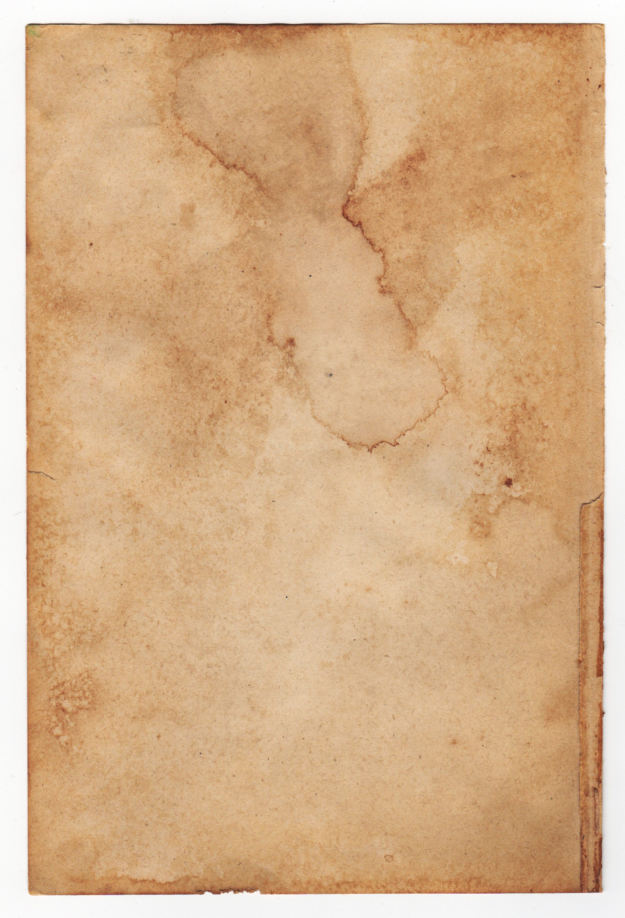
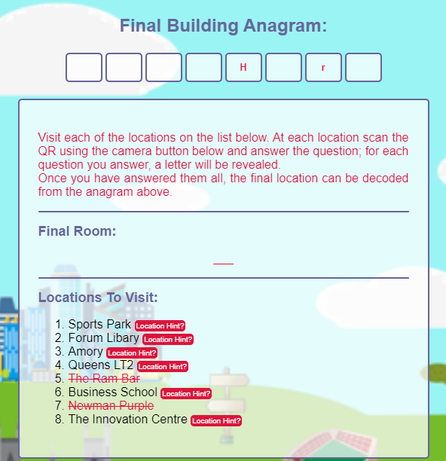
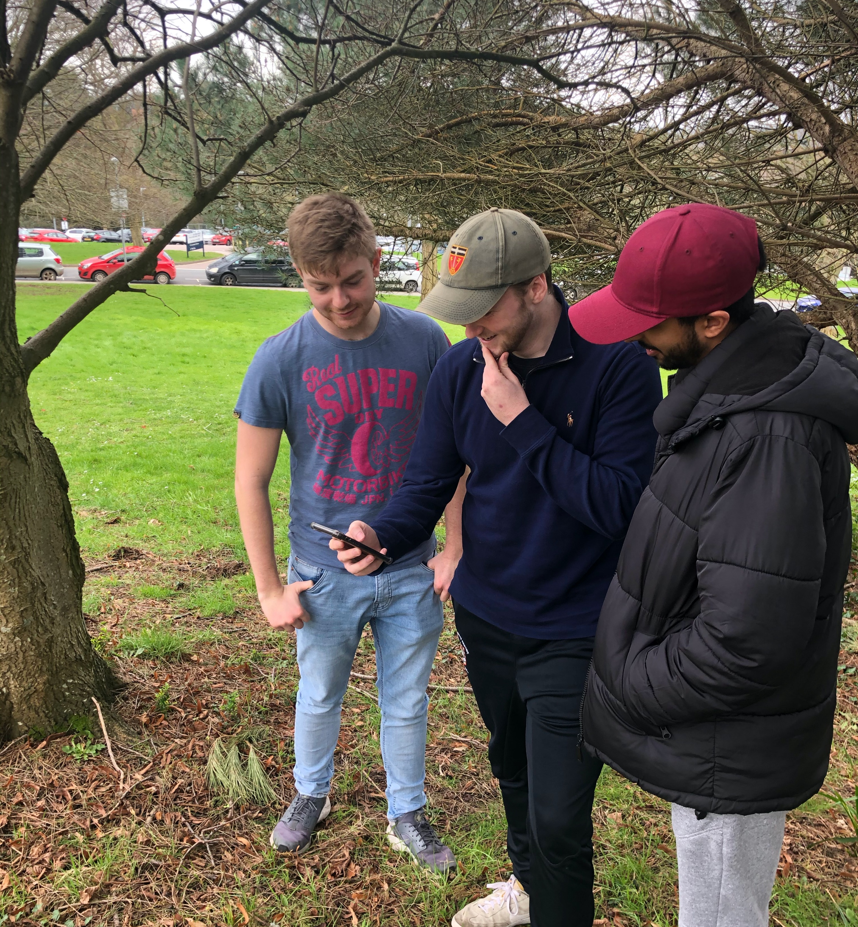


UNIVERSITY OF EXETER FRESHERS TREASURE HUNT
GAME PREMISE
Our treasure hunt ultimately takes the form of the world-famous hangman game.
As you visit each of the locations on the dashboard and scan the QR code, you are presented with a question.
Successful answering of the question will result in you obtaining a letter, filling out an anagram of the building of the team’s tutor’s location.
Once all letters have been obtained, the room of the tutor will be presented.
The game helps to build a sense of achievement in the teams through cooperation and perseverance.
Above: Screenshot of our app in use
FUN FEATURES
Hangman style game!
Visit all of the main locations on the Streatham Campus
Competitive feel with a live leader board
Collect all of the letters to reveal your final location
Easy for admins to track progress of all teams
Text-to-speech built in so you don’t even have to read the questions!
Built in map to make finding your way even easier
Useful information on lecturers and general FAQs to help the transition to university life.
Look how much fun these students are having!
GROUP B

